Slide 1
Health, Income, and Emission Effects from Energy Generation
By: Alex H, Evan O, Scott M, Robbie G, and Jennifer H

Slide 2
Probing Question
How much does energy generation effect the health, income, and emissions of states and the people therein?

Slide 3
Overview
Energy Source Generation and Emissions
Emissions and Respiratory Health
Energy Source Generation and Income
Impact of Findings
Future Projects/Limitations of Data
Q&A

Slide 4
Energy Generation Dataset
Source: U.S Energy Information Association
Units: Megawatt hours
Displayed time period 2000, 2005, 2010, 2014
Energy sources analyzed: Natural Gas, Coal
Analyzed data for each state
Graphical representation (line plot, bar plot)

Slide 5
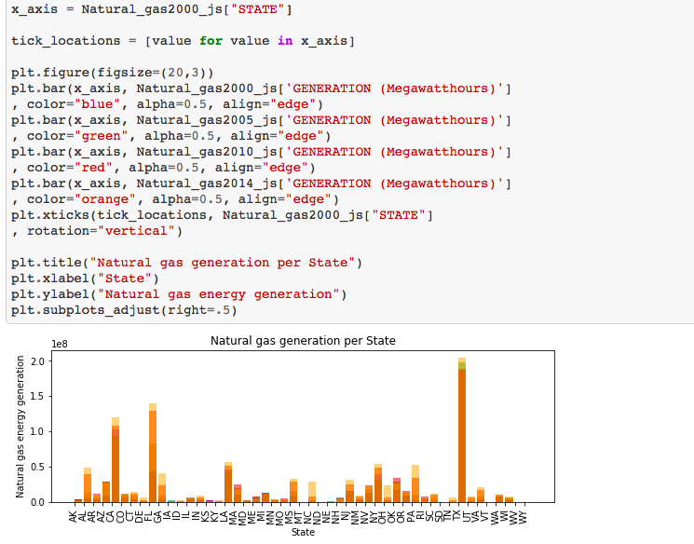
Plot of Energy sources

Slide 6
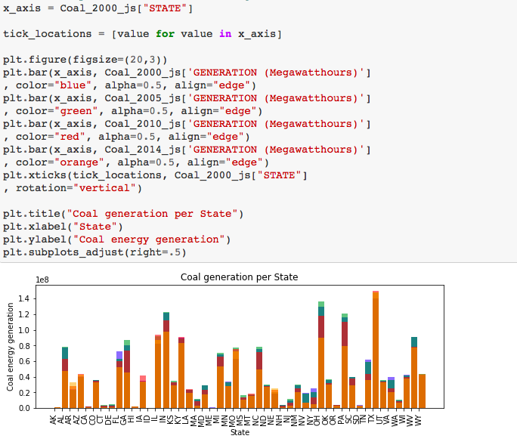
Energy Generation Plots

Slide 7
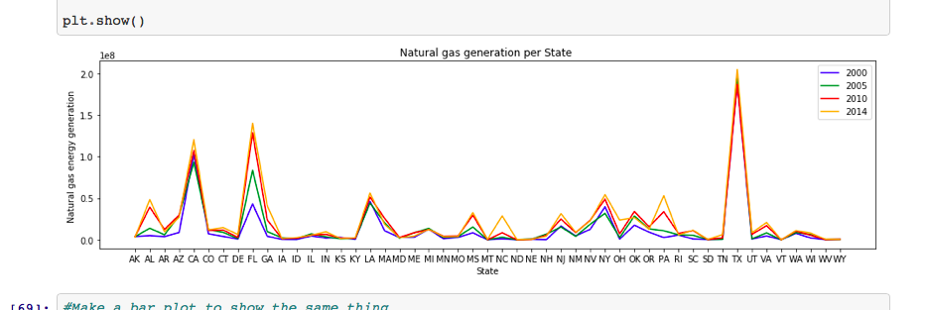
Energy Generation Natural Gas Line Plot

Slide 8
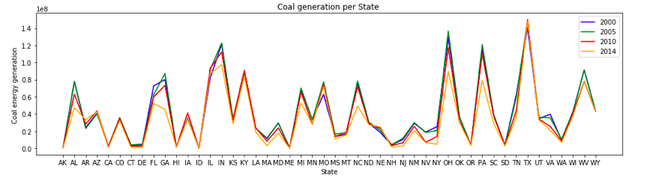
Energy Generation Coal line plot

Slide 9
Energy Source Generation and Emissions
Since 1996, CO2 levels have increased, levelled off in the Mid-2000’s, then decreased in the US
Since 1996, NOx and SO2 has been on a decline
The only significant increase of emissions has been in CH4 emissions, presumably as we’ve moved away from coal to Natural Gas and Petroleum energy production

Slide 10
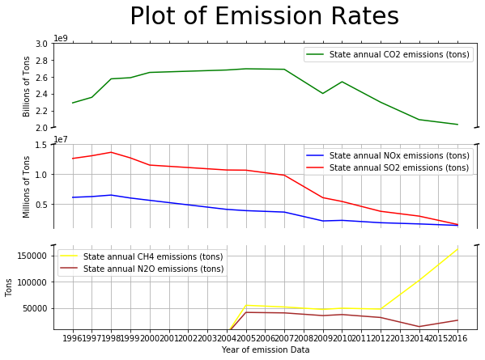

Slide 11
Mortality Rate Dataset
Source: Institute for Health Metrics and Evaluation
Deaths per 100,000 population
Measured every five years
Aggregate of common chronic respiratory diseases
Chronic obstructive pulmonary disease, silicosis, asbestosis, coal workers’ pneumoconiosis, other pneumoconiosis, asthma, interstitial lung disease, other chronic respiratory disease

Slide 12
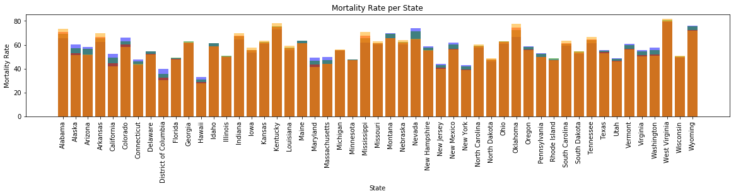

Slide 13
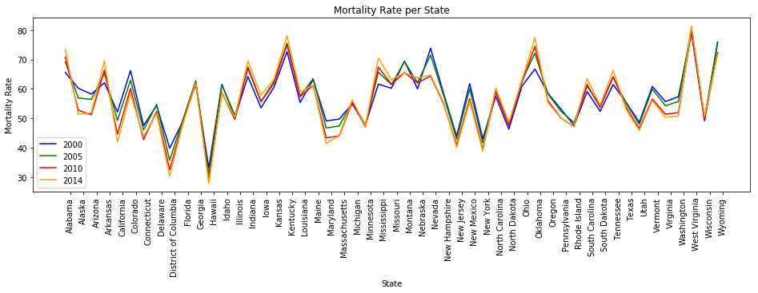

Slide 14
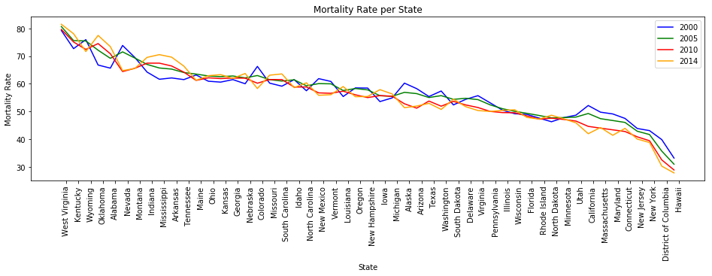

Slide 15
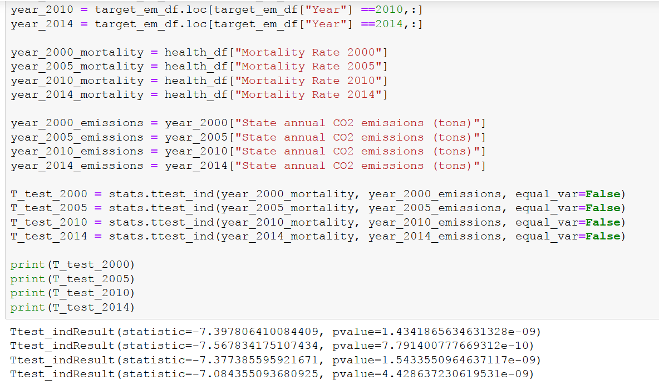
Independent T-test
Isolated CO2 emissions and mortality rates by state
Performed four T-tests (2000, 2005, 2010, 2014)
Tests yielded significant results

Slide 16
Energy Source Generation and Income
Source: census.gov
Units: Dollars Analyzed Data against Energy Generation Data by State
2000 pvalue=0.04847186320142362
2005 pvalue=0.04844027076978867
2010 pvalue=0.04847054559402875
2014 pvalue=0.048586216961623935

Slide 17
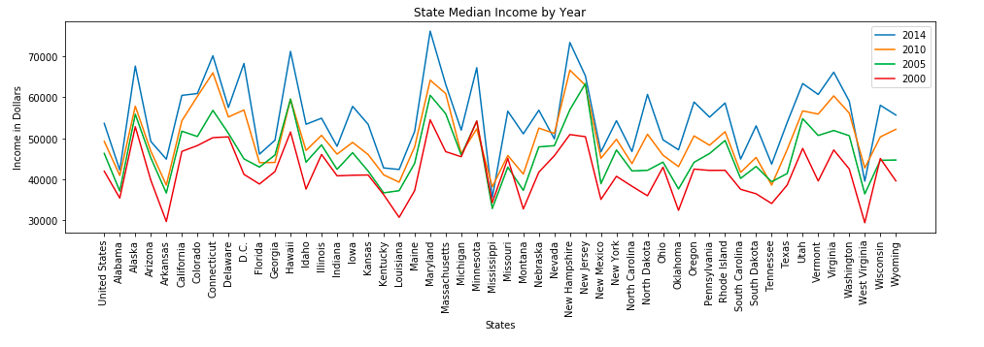
Impact of Findings

Slide 18
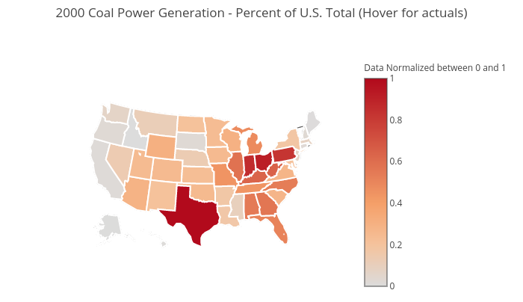
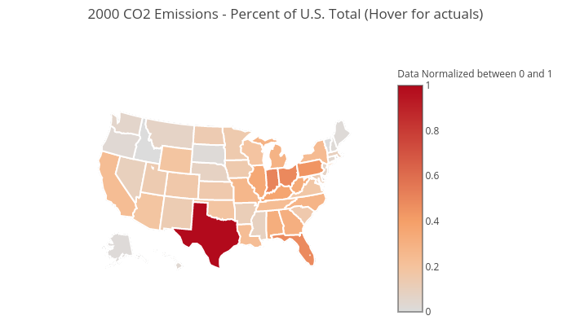
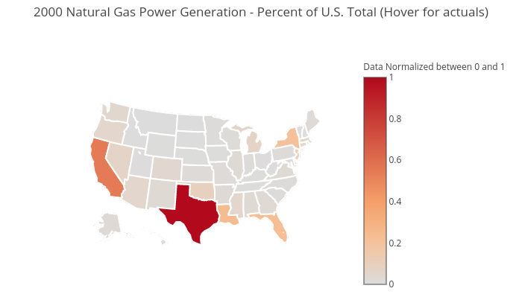
How does the fluctuation of energy source generation effect emissions? Year 2000
Click map to view actuals

Slide 19
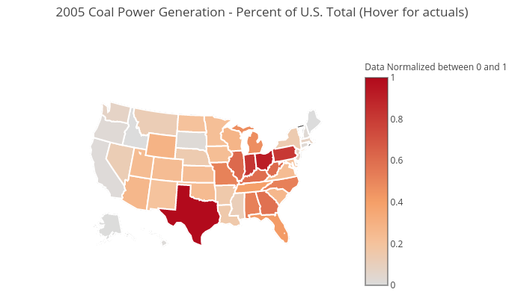
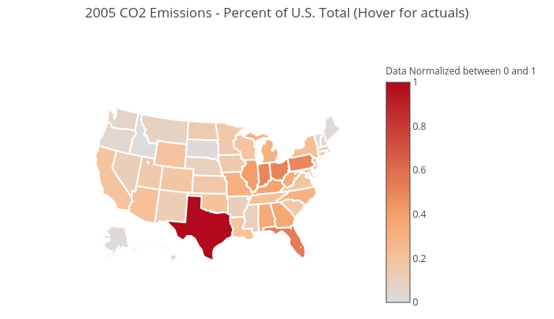
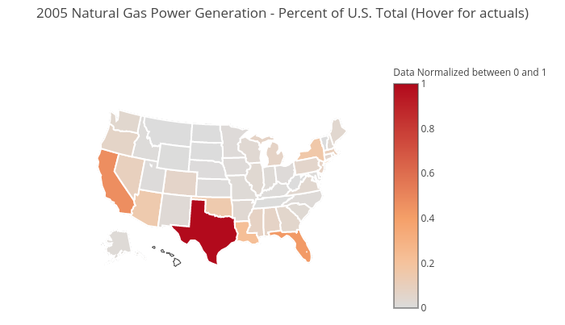
How does the fluctuation of energy source generation effect emissions? Year 2005
Click map to view actuals

Slide 20


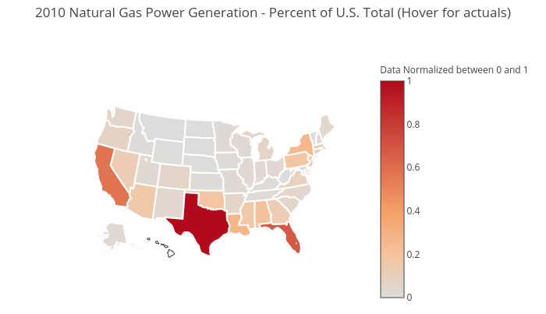
How does the fluctuation of energy source generation effect emissions? Year 2010
Click map to view actuals

Slide 21
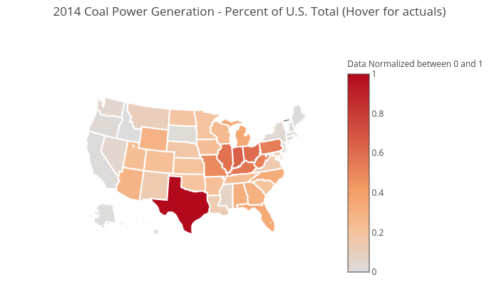

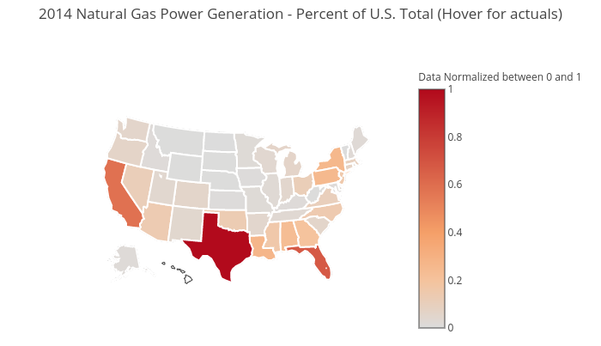
How does the fluctuation of energy source generation effect emissions? Year 2014
Click map to view actuals

Slide 22
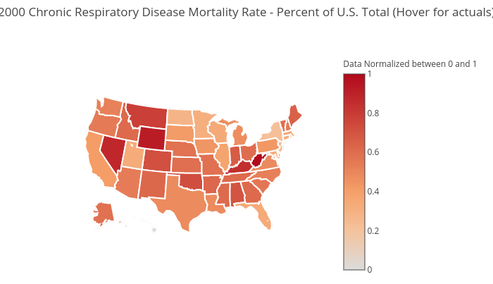
How does emissions effect respiratory health? Year 2000
Chronic Respiratory Disease Mortality Rate
CO2 Emissions
Click map to view actuals

Slide 23

How does emissions effect respiratory health? Year 2005
Chronic Respiratory Disease Mortality Rate
CO2 Emissions
Click map to view actuals

Slide 24

How does emissions effect respiratory health? Year 2010
Chronic Respiratory Disease Mortality Rate
CO2 Emissions
Click map to view actuals

Slide 25
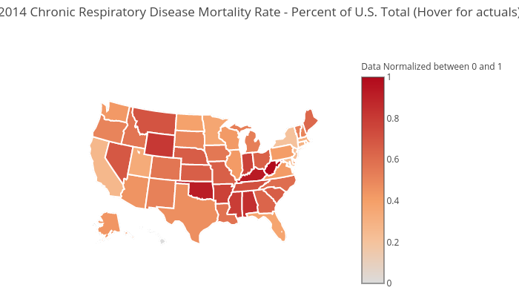
How does emissions effect respiratory health? Year 2014
Chronic Respiratory Disease Mortality Rate
CO2 Emissions
Click map to view actuals

Slide 26
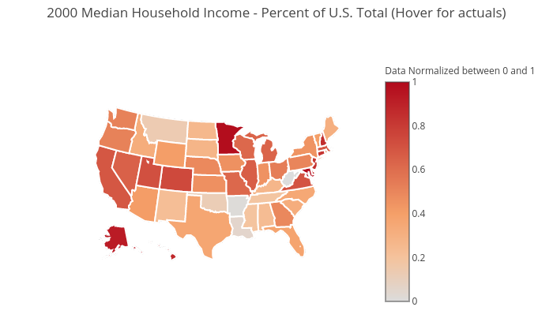
How does energy source generation relate to income? Year 2000
Click map to view actuals

Slide 27
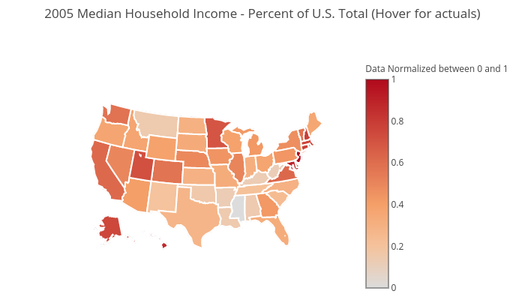
How does energy source generation relate to income? Year 2005
Click map to view actuals

Slide 28
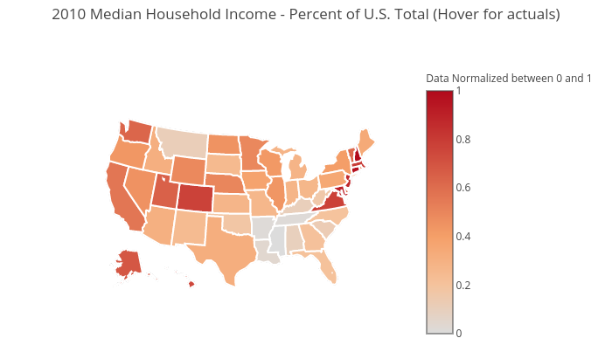
How does energy source generation relate to income? Year 2010
Click map to view actuals

Slide 29
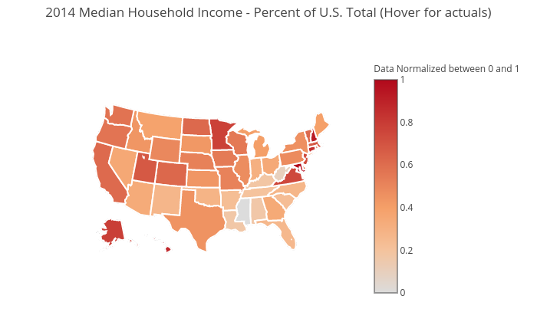
How does energy source generation relate to income? Year 2014
Click map to view actuals

Slide 30
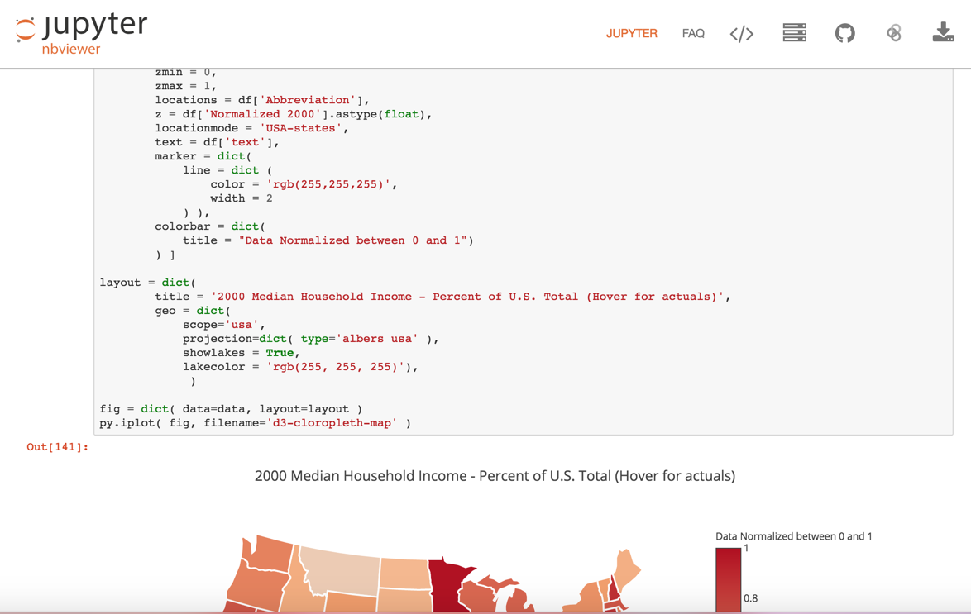
View Map Code on Jupyter nbviewer

Slide 31
Current Limitations and Future Projects
Emission data does not exist for every year, and some emission types were not tracked by the EPA prior to 2005
The years selected were due to the lack of Mortality Rate
The data would be best represented on a per capita level

Slide 32
Conclusion
Overall, we found that more energy source generation does mean more emission output, resulting in a higher respiratory disease rate in those states, and a positive correlation between energy source generation with median income. Therefore, since they are all related we can say according to our data, higher energy source generation results in higher emission output, and higher respiratory disease rate; however, you may find this acceptable because the median income in the state with a higher energy source generation tends to be higher.

Slide 33
Questions?

